Slide 1
Company X Employee Attrition Problem
Analysis, interpretation, prediction

Slide 2
Content
Introduction
Data Exploration
Model Development
Interpretation
Prediction
Notes:
fausatbolaibrahim@gmail.com

Slide 3
Introduction
Employees are the greatest assets of a company and Employee Attrition is a crucial problem that creates vacuum and poses human resources management challenges for the company. The goal of this project is to use Data Analysis techniques and Business intelligence tool to understand Company X Attrition case, to determine the reason why Employees are leaving, and predict the Employees that are prone to leave the Company next.
I shall use the Random Forest Classifier – a Machine Learning Algorithm to analyze the datasets. This ensemble learning combines multiple decision trees or more learning models to gain average and build better predictive result, rather than relying on one decision tree. Thus, I am enthusiasm about the accuracy of the outcome of the prediction.

Slide 4
Data Exploration
A critical look at our data set using pandas, numpy and scikit-learn, our model clearly predict that high employee dissatisfaction in some of the variables presented is responsibe churning. According to our model, salary variable tends to have higher impact, and/or is a determinant to who leaves, why, and when the employee leaves Company X. Our model confirms accuracy of 98% . It also help to understand that great relationship exist between the datasets.
Visualizing the dataset of those that already left the company help me to make informed predictions about the existing employee because of great similarity in the structure of the data. It is discover that majority of the ex-employees are from Sales, Support, and Technical department due to low salary .Lets gets to dive with Python…importing a few Libraries:
Notes:
fausatbolaibrahim@gmail.com

Slide 5
Data Exploration
import numpy as np
import pandas as pd
import matplotlib.pyplot as plt
import seaborn as sns
# Importing Dataset
ex_emp = pd.read_csv("Ex_Employees.csv")
print (ex_emp.head())
exi_emp = pd.read_csv("Employee_existing.csv")
print(exi_emp.head())
comb = ex_emp.append(exi_emp)
print(comb.head())
(comb.drop("Emp ID", 1)
ex_emp.drop("Emp ID", 1)
exi_emp.drop("Emp ID", 1)
#Employee relationship with the other variables.
Notes:
fausatbolaibrahim@gmail.com

Slide 6
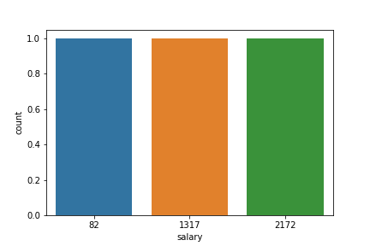
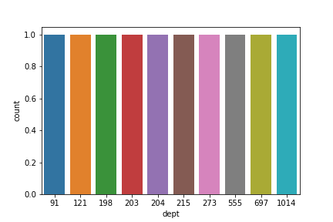
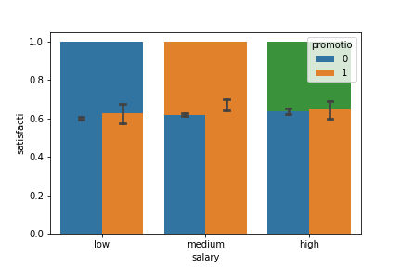
Data Exploration
print(ex_emp['dept'].value_counts())
print(ex_emp['salary'].value_counts())
#Visualising our variables
print(ex_emp['dept'].value_counts())
plt.savefig(‘dept.png')
print(ex_emp['salary'].value_counts())
plt.savefig(‘salary.png')
sns.barplot(y = "satisfacti", x = "salary", data = comb, hue = "promotio", capsize =.05 )
plt.savefig('sal_promotion_satis.png')
sns.pairplot(comb)
plt.savefig('fig1.png')
# Encoding dependent variable
from sklearn.preprocessing import LabelEncoder
le = LabelEncoder()
y = le.fit_transform(y)
X = ex_emp.iloc[:, [0,1,2,3,4,5,6,7]].values
print(X.shape)
y = ex_emp.iloc[:, 8].values
print(y.shape)
Notes:
fausatbolaibrahim@gmail.com

Slide 7
Data Exploration
# Training dataset in to test train
from sklearn.model_selection import train_test_split
X_train, X_test, y_train, y_test = train_test_split(X,y, random_state = 0, test_size = 0.25)
# Fitting Decision Tree to Training set
from sklearn.tree import DecisionTreeClassifier
classifier = DecisionTreeClassifier(criterion='entropy', random_state=0)
classifier.fit(X_train, y_train)
#Get the accuracy on the training data
forest.score(X_train, y_train)
# Return the feature importances (the higher, the more important the feature).
importances = pd.DataFrame({'features':ex_emp.iloc[:, [0,1,2,3,4,5,6,7]].columns,'importance':np.round(forest.feature_importances_,3)}) #Note: The target column is at position 0
importances = importances.sort_values('importance',ascending=False).set_index('features')
importances
importances.plot.bar()
plt.savefig('importance.png')
Notes:
fausatbolaibrahim@gmail.com

Slide 8
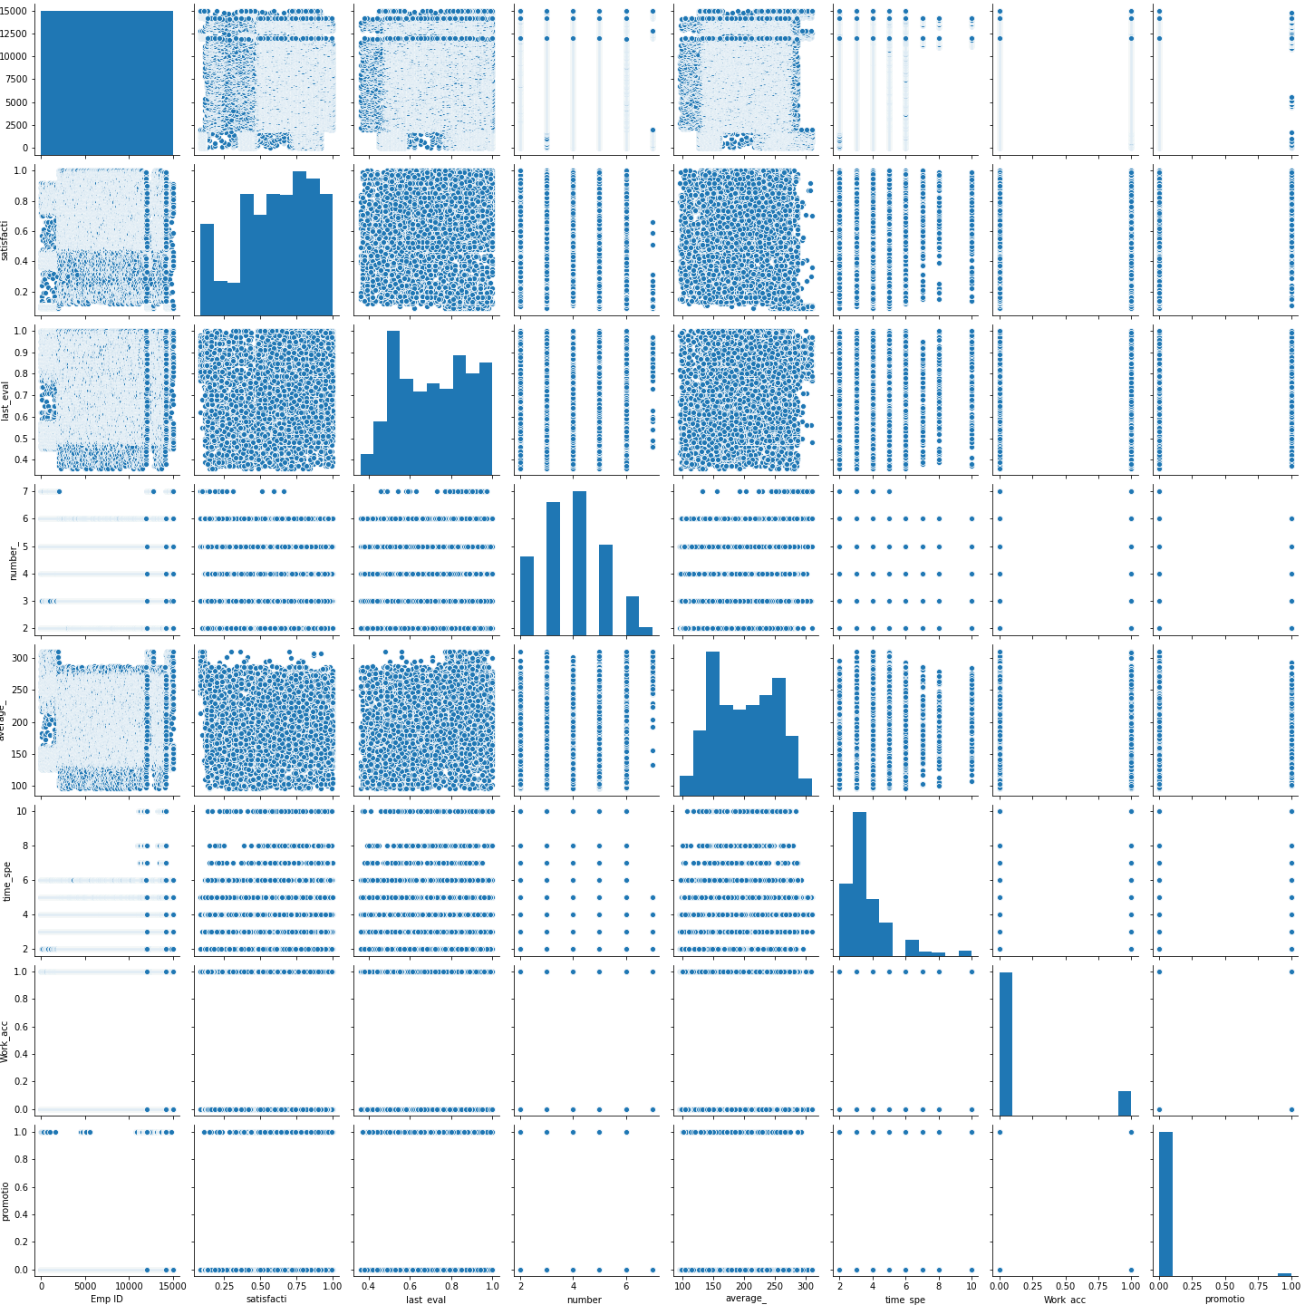
Data Exploration
Notes:
fausatbolaibrahim@gmail.com

Slide 9
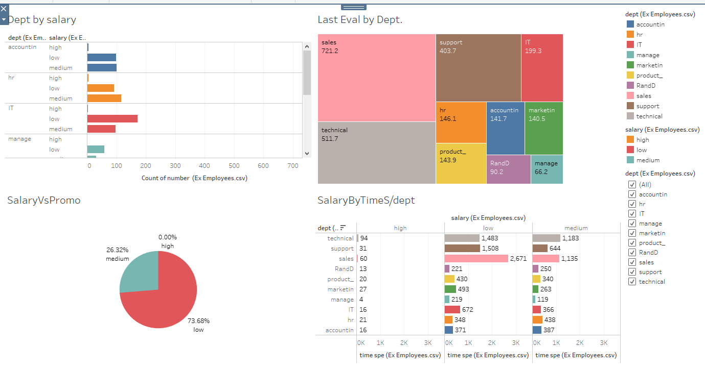
Data Exploration
Notes:
fausatbolaibrahim@gmail.com

Slide 10
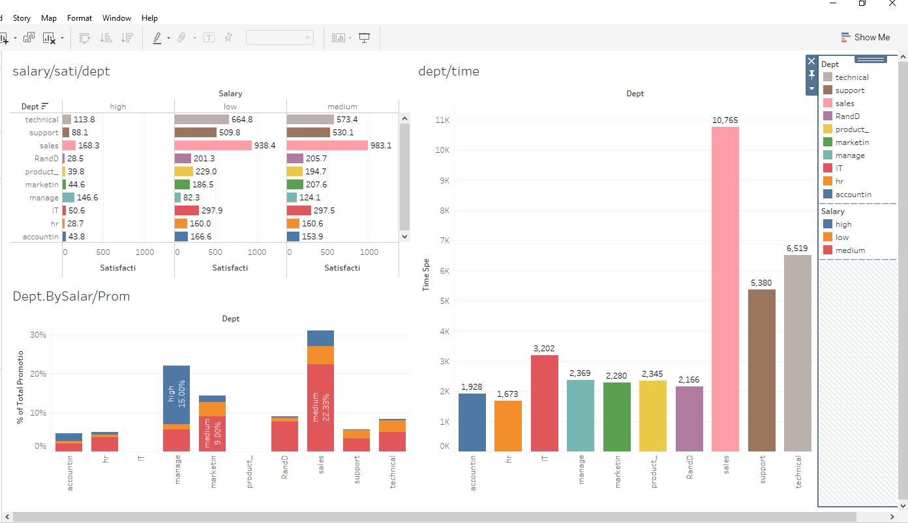
Data Exploration
Notes:
fausatbolaibrahim@gmail.com

Slide 11
Model Development
Based on our Modelling analysis, Employee ID has no relationship whatsoever with other variables. However, there exist high level of relationship and correlations between all other variables in our datasets.
The relationship between salary, promotion, satisfaction and Department of operation is remarkable; and it is necessary we explore it as this explains the reason why majority of the employees are leaving Company X.
The relationship between Number of Project, Average Monthly hours, and the time spent in the Company X cannot be under emphasized.
Notes:
fausatbolaibrahim@gmail.com

Slide 12
Interpretation - Story from our modelling and data exploration
From the analysis and visualization, we realized that:
Employees who tends to have high level of promotion in the last five years in Company X are majorly on low salary scale
It is evident that promotion percentage is the three level of salary is on 74%, 26% and 0% for low, medium and high salary structure respectively and this is uneven. In essence, that an employee is been promoted often does not really determine if that employee will stay, but the content of such employee salary does.
Our exploration of the variables promotion, salary and satisfaction reveals that employees on low salary despite been promoted often have low satisfaction, this is understandable as the salary is still low. Surprisingly, employees on high salary scale satisfaction level is somewhat low too, while employees on medium salary satisfaction level is highly impressive
Notes:
fausatbolaibrahim@gmail.com

Slide 13
Interpretation - Story from our modelling and data exploration
Relating our analysis and relating it to the department, Sales Department has highest number of Employees within the company and they constitute high percentage of staff on low salary. Employees from Technical and Support Departments are more on medium salary and this explains the reason why when we evaluate Satisfaction level with Department of engagement, our indices rates higher in employees in the Technical Department then, Supports and Sales Departments.
Evaluating Average monthly hours with number of projects and salary, it is discovered that, low salary Employees have highest number of projects and monthly working hours. Reverse is the case for Managers, who are on high salary scale, with low percentage. Our assessment reveals that percentage of the Employees who have highest number of time spent in Company X, ar is higher with employee on low salary as against medium and high salary.
Notes:
fausatbolaibrahim@gmail.com

Slide 14
Prediction
Thus, it is remarkable to note that higher scale of employees who have left Company X are majorly from Sales Department since they are mostly on low salary scale. Ex-employees from Support and Technical Departments are also high compare to other departments.
From the foregoing, employees that leave the company majorly, are those on low, and then medium salary structure. Do note high percentage on low salary. We realize that these set of employees might have gotten promoted recently, they tend to work for longer hours, tend to have more projects, but have lower level ofsatisfaction.
Based on the dataset of the Existing Employees in Company X, it is logical to predict that, majority of the Employees that will leave the company would come from the Sales, Support and Technical Departments, with emphasis on Sales Department.
Notes:
fausatbolaibrahim@gmail.com

Slide 15
loration
Thank you
Notes:
fausatbolaibrahim@gmail.com

